Slide 1







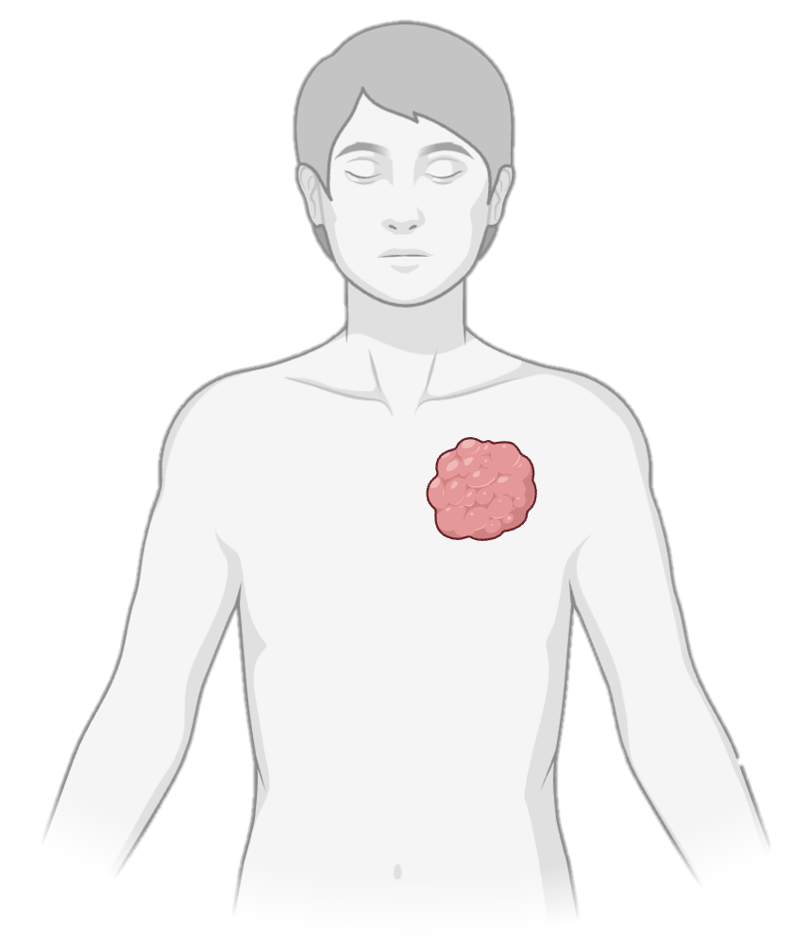
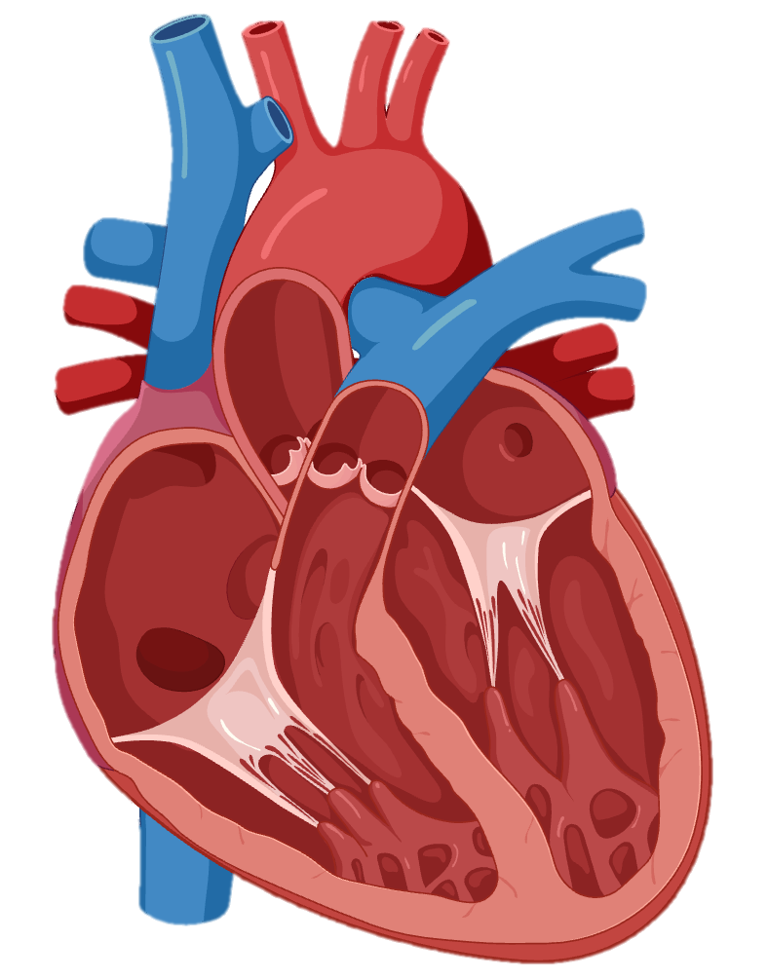
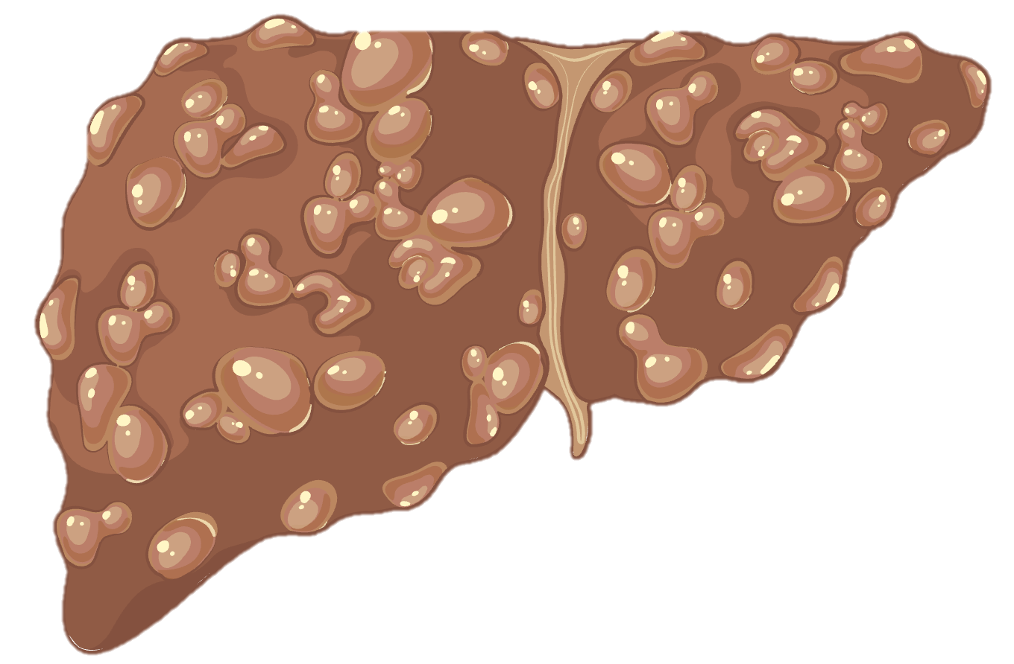
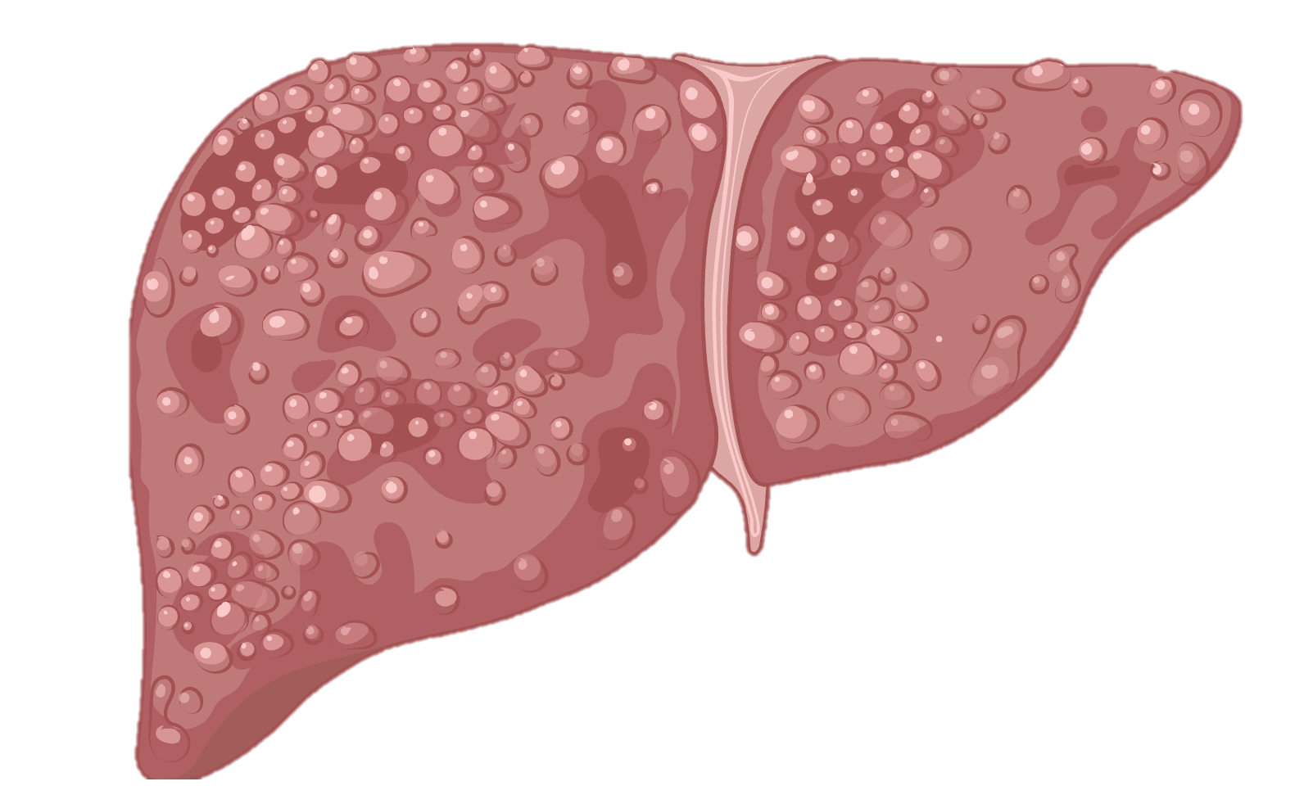
Combination therapy outcomes vary by treatment sequence and baseline risk profiles
GLP-1 RA initiators
Statin initiators
Predominant metabolic dysfunction
(obesity, insulin resistance, hyperglycemia)
Predominant cardiovascular risk
(dyslipidemia, atherosclerosis)
MASLD
Population
(multisystem disease)
Add-on GLP-1 RA
Add-on statin
GLP-1 RA initiators → Add-on statin
Statin initiators → Add-on GLP-1 RA
Cirrhosis and Decompensated cirrhosis
~35% risk
Non-liver cancers
~30% risk
Cardiovascular disease
~ 30% risk
Decompensated
cirrhosis
~20% risk

